Slide 1
Banking application

Slide 2
Overview of project
This application provides us 3 choices
Create account - To create a new account
Transfer money - To transfer money from one account to another
Display balance - To display balance of given account number
Based on the user choice corresponding choice will get executed

Slide 3
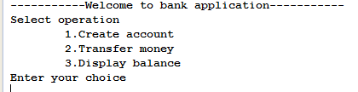
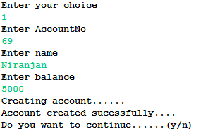
Workflow of application
Initially we will show welcome message with user options
After selecting first option it will ask for details’s to create account

Slide 4

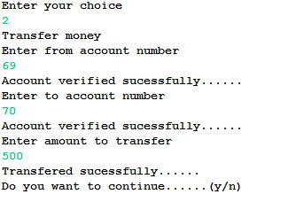
If account already exists then it will show corresponding message
If we select transfer amount option from the menu then

Slide 5
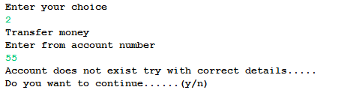
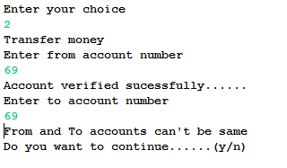
If we enter wrong account number while transferring money
If both from and to account numbers are same

Slide 6
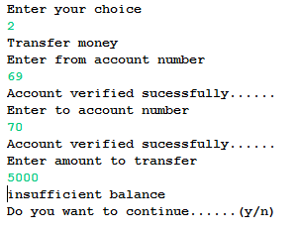
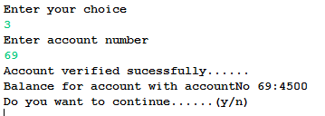
If we don’t have sufficient balance while transferring
If we select display amount option

Slide 7

If select no option then it exit displaying thankyou message

